Slide 1
Title -Java Features and Architecture of Java
Presented by: Pratiksha Sapkale

Slide 2
Introduction to Java
What is JAVA ?
High-level, object oriented programming language
Developed by James Gosling and team Sun Microsystems, released in 1995
Platform-Independent (“Write Once, Run Anywhere”)
Java programs are compiled into byte code

Slide 3
Types of Java applications
Web Application : Run on web browser using servlet, JSP, struts technologies. Create java web applications and deploy them on server.
Mobile Application : These are mobile aaplications are created using java.
Standalone Application : Executed by themselves without the need of other programs and files. Example of such an application is antivirus.
Enterprise Application : Designed for corporate organizations with the intent to control major process in real time.

Slide 4
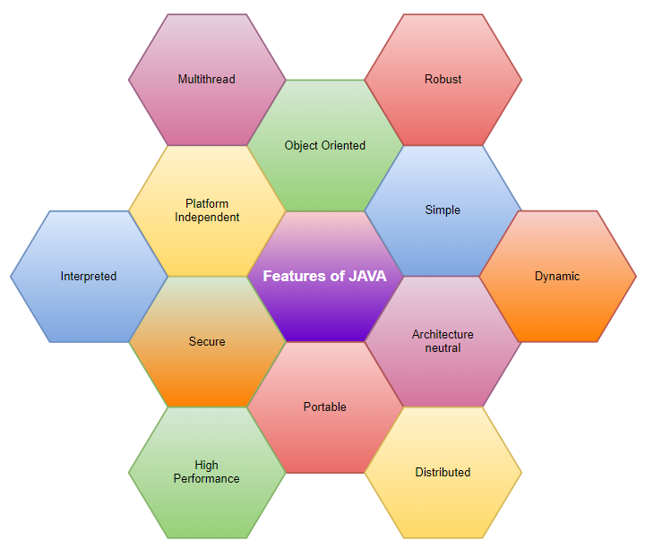
FEATURES OF JAVA

Slide 5
Key Features of Java
Object-Oriented : Focuses on objects and classes
Platform-Independent : Code can run on any device with a Java Virtual Machine (JVM)
Simple and Easy to Learn : Designed to be accessible and user-friendly
Robust and Secure : Includes strong memory management and security features
Multithreaded : Supports concurrent execution for better performance
Portable : Consistent across platforms due to bytecode
High Performance : Just-In-Time (JIT) compiler improves runtime performance

Slide 6
Interpreted: Java converts high-level program statement into Assembly Level Language, thus making it interpreted.
Distributed: Java lets us create distributed applications that can run on multiple computers simultaneously.
Dynamic: Java is designed to adapt to ever evolving systems thus making it dynamic.
Portable: Java is not necessarily fixated to a single hardware machine. Once created, java code can be used on any platform.
Architecture Neutral: Java is architecture neutral meaning the size of primitive type is fixed and does not vary depending upon the type of architecture.

Slide 7
Introduction of JAVA Architecture
Java Architecture is a collection of components, i.e., JVM, JRE, and JDK.
It integrates the process of interpretation and compilation.
It defines all the processes involved in creating a Java program.
Java Architecture explains each and every step of how a program is compiled and executed.

Slide 8
Java Architecture can be explained by using the following steps:
There is a process of compilation and interpretation in Java.
Java compiler converts the Java code into byte code.
After that, the JVM converts the byte code into machine code.
The machine code is then executed by the machine.

Slide 9
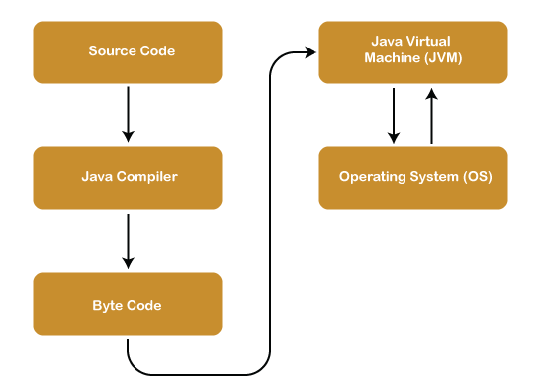
ARCHITECTURE OF JAVA

Slide 10
Components of Java Architecture
The Java architecture includes the three main components:
Java Virtual Machine (JVM)
Java Runtime Environment (JRE)
Java Development Kit (JDK)

Slide 11
Java Virtual Machine
Our Java program can run any of the platforms only because of the Java Virtual Machine.
JVM's main task is to convert byte code into machine code.
JVM, first of all, loads the code into memory and verifies it. After that, it executes the code and provides a runtime environment.

Slide 12
Java Runtime Environment
Java Run-time Environment (JRE) is the part of the Java Development Kit (JDK).
It is a freely available software distribution which has Java Class Library, specific tools, and a stand-alone JVM.
The JRE loads classes, verify access to memory, and retrieves the system resources.
JRE acts as a layer on the top of the operating system.

Slide 13
Java Development Kit
The Java Development Kit (JDK) is a superset of JRE .
IT is used to create java applications.
There are three JDK provided by Oracle; Java Enterprise Edition (Java EE), Java Standard Edition (Java SE), and Java Mobile Edition (Java ME).
The execution of a program is done with all these three components.

Slide 14
THANK YOU!

